Slide 1
Create/distrubute vector tile
Taro Matsuzawa
Georepublic
https://github.com/smellman/jica_2019

Slide 2
Self-Introduction
Senior Developer of Georepublic
Programming: Python, Ruby, JavaScript, Java, and others
Computer skill: UNIX and Linux, Networking(L1 to L7), Virtual Machine (VirtualBox, KVM, Docker)
GIS skill: Data processing, Tile
Computer community:
OSGeo.JP
OpenStreetMap Foundation Japan
Japan Unix Society
Mozilla community in Japan
Contact: taro@georepublic.co.jp or @smellman

Slide 3
Topics:
Short introduction of `unvt`
Introduction of the tile technology
Introduction of software and data
Vector Tiles
Short demonstration with `inazo`
Create Vector Tiles from vector files
Styling Vector Tiles
Hosting

Slide 4
unvt

Slide 5
What is `unvt`
`unvt` means United Nations Vector tile Toolkit.
Mr. Fujimura started this project when he worked in UN.
Toolkit means `collection of softwares`.
All software include in one Docker image.

Slide 6
Docker
Docker is container technology.
Docker image contains basic OS and software.
Docker runs in too many platform.
Desktop OS: Linux, Windows, macOS…
Cloud platform: AWS, Google, Azure(Microsoft)
Others: Raspberry Pi 3.
This presentation targets Raspberry Pi 3.

Slide 7
Raspberry Pi
A small single-board computer.
Developed in the UK by the Raspberry Pi Foundation.
Teaching of basic computer science in schools and in developing countries.
You can build development environment with low cost.
Raspberry Pi 3 = $35
microSD Card (128GB) = $20
LAN Cable = $5

Slide 8
Docker and Raspberry Pi
Raspberry Pi supports Debian Linux based `Raspbian OS`.
Raspbian OS supports Docker.
We targets converting small data to vector tile.
If you build vector tile from big data(such as OpenStreetMap) or build raster tile, you may need some Desktop or laptop because it requires memory.
We can’t test Raspberry Pi 4 with 4GB memory because currently we can’t buy it in Japan.

Slide 9
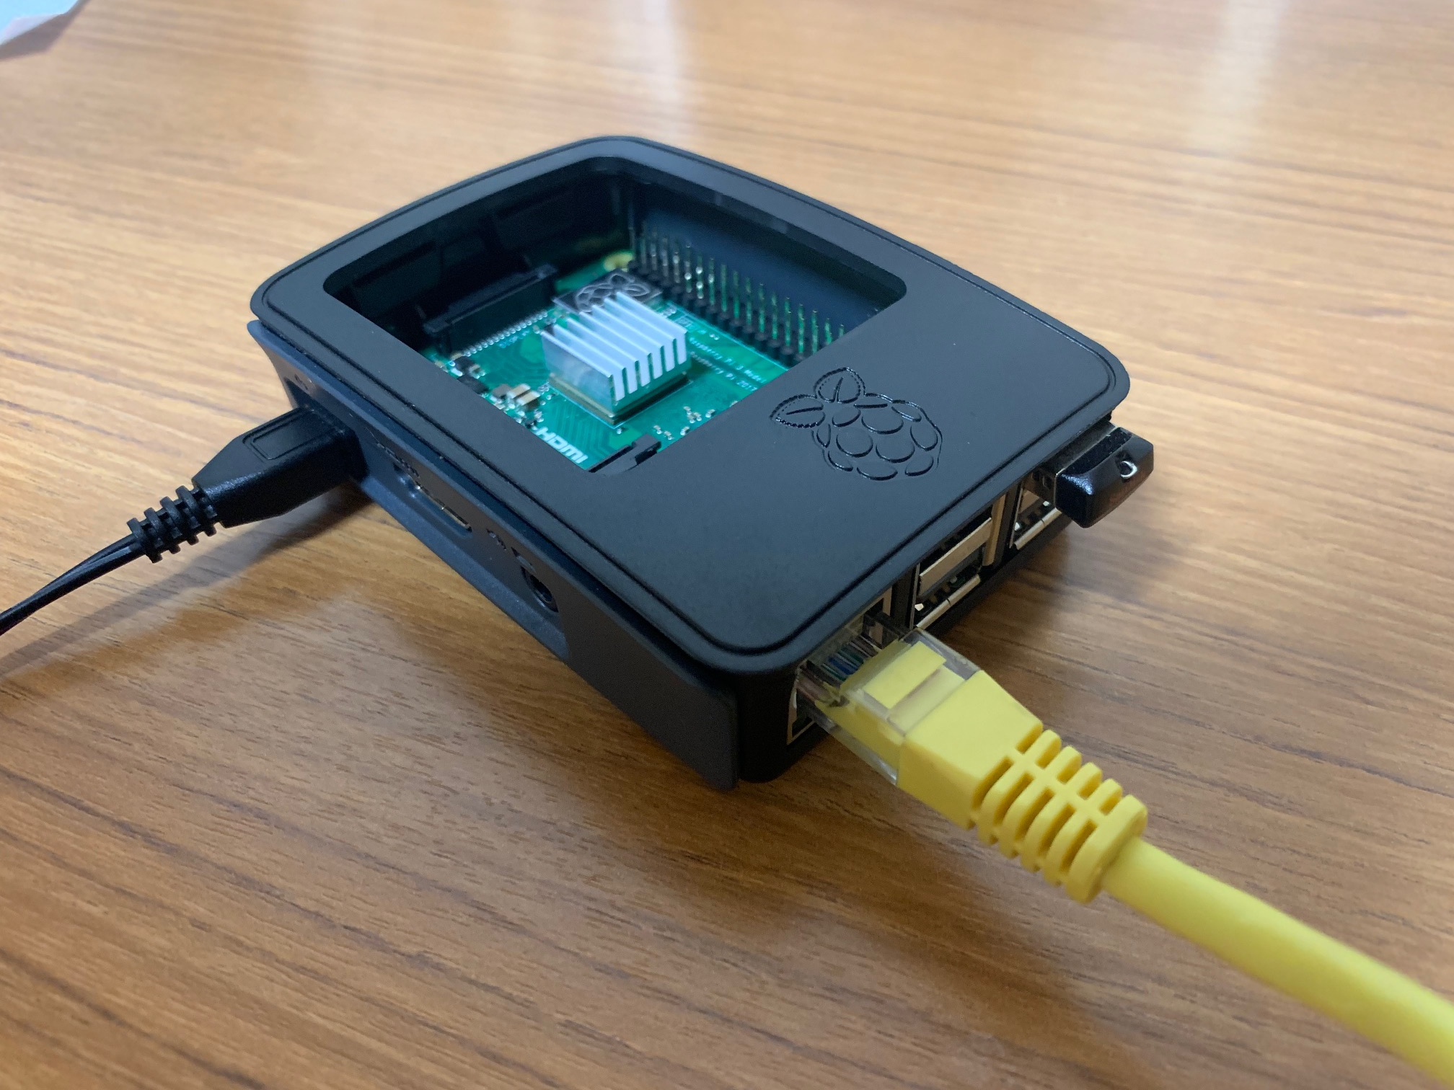
Concept image
Web maps without the Internet
CPU
Tiles
OS
5V DC
To PC or Intranet

Slide 10
Docker images
`unvt/rasv`
Basic image includes some software.
`unvt/ango`
Extra image for FOSS4G 2019 Niigata Hands on.
`unvt/inazo`
Extra image for JICA 2019 Seminar.
Includes hosting program and Euro data from Global map project.
This presentation use this image.

Slide 11
Introduction of the tile technology

Slide 12

Tile technology
Provide map images or data over the internet.
Map images are separated as tile.
Zoom Level 0 = World
Each zoom level doubles in the dimensions.
Too many tiles use “Web Mercator projection”.
Structure of tile is useful to web.
Scroll, zoom up/down with AJAX request.
Tile become known for Google Maps.
Tile has existed from the late 1990s.
https://a.tile.openstreetmap.org/0/0/0.png

Slide 13
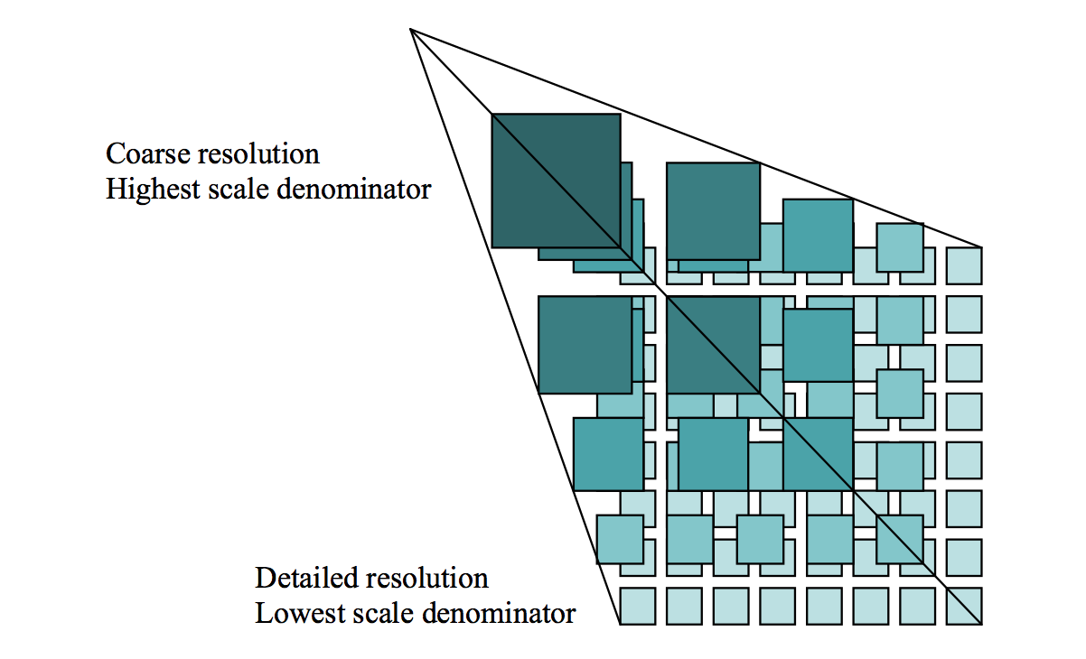
Zoom
Zoom level 0 : 1 file
Zoom level 1 : 2 x 2 = 4 files
Zoom level 2 : 4 x 4 = 16 files
…
Zoom level 18 262,144 x 262,144 = 68,719,476,736 files

Slide 14
Request
Many service use REST API (GET).
https://…/Z/X/Y.Format
Z = Zoom Level
X = X coordinate
Y = Y coordinate
Format
Raster image format (png, jpg, webp)
Vector data format (pbf, mvt)

Slide 15
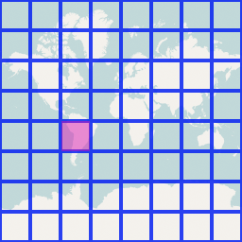
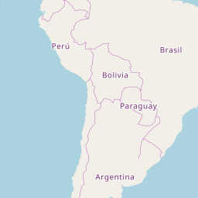
Request example
http://a.tile.openstreetmap.org/3/2/4.png
Zoom=3, X=2, Y=4, format=PNG
X and Y coordinates start with 0.

Slide 16
Web Mercator
Cut off coverage at 85.051129° north and south.
EPSG:3857
Famous as “OpenLayers:900913” (Google)
85.051129°
-85.051129°

Slide 17
Specification
Two tile service specifications
Tile Map Service (TMS)
Web Map Tile Service (WMTS)
TMS is simple than WMTS.
TMS’s X Y coordinate is started from bottom left.
Same as Cartesian coordinate system.
WMTS‘s X Y coordinate is started from top left.
Same as Coordinate system for 2D computer graphics.

Slide 18
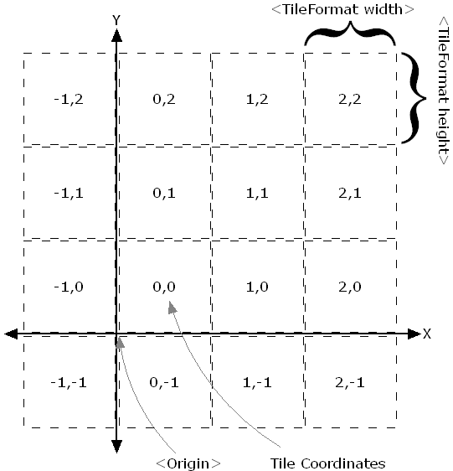
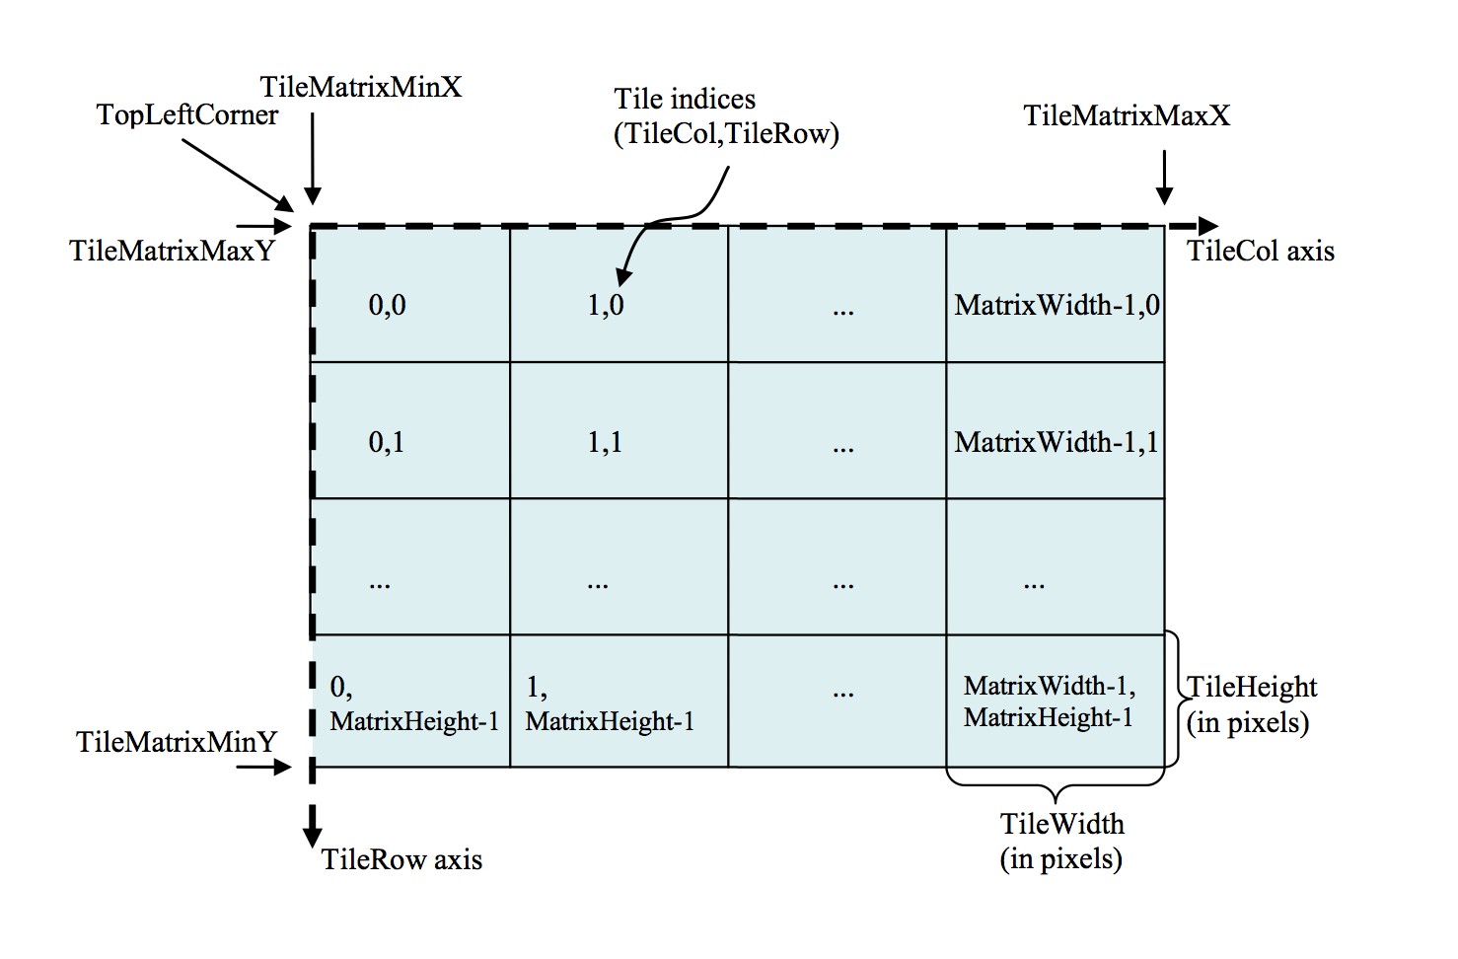
Difference between TMS and WMTS
TMS
WMTS

Slide 19
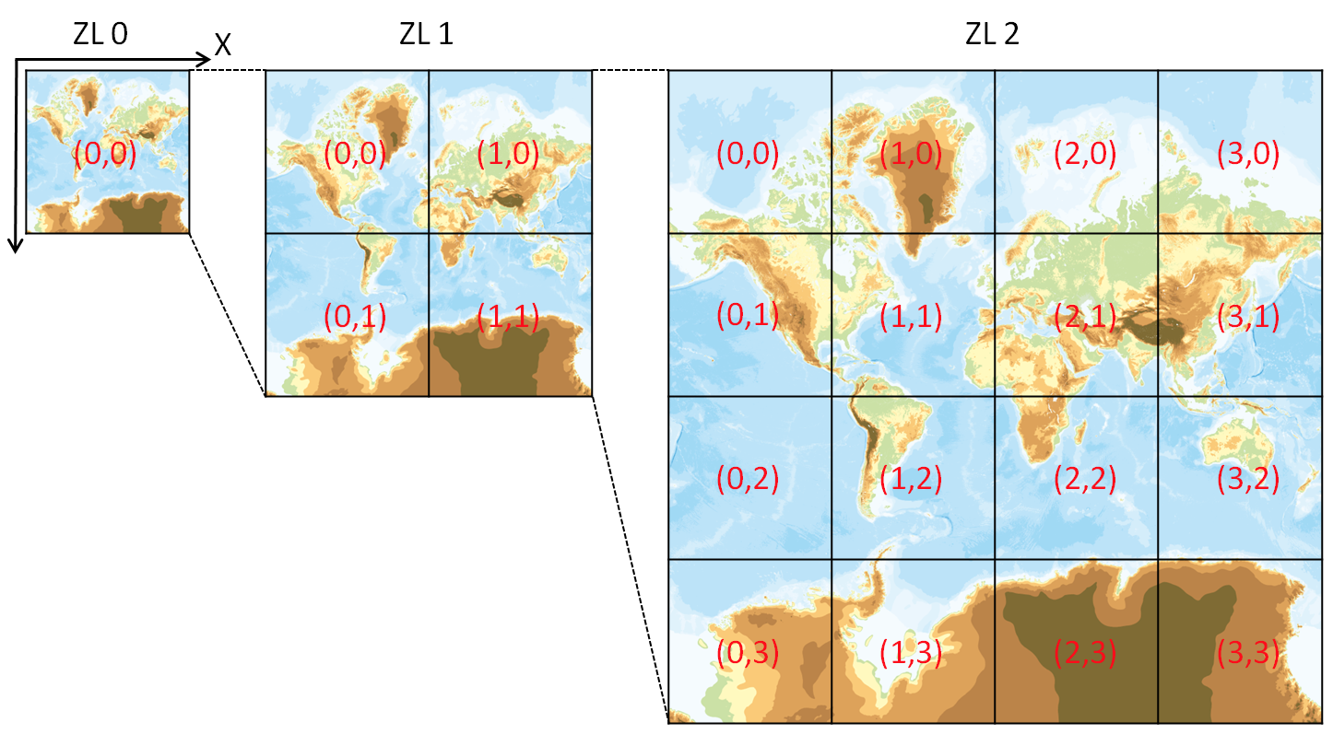
The Y coordinate flipped
OpenStreetMap use TMS like protocol but The Y coordinates are numbered from top left.
If take no thought of meta data, Y coordinate flipped TMS equals WMTS.
GSI Map use this rule too.
OpenStreetMap call “Slippy Map”
We call zxy tile
{z}/{x}/{y}.png
Also call xyz tile

Slide 20
ZXY Tile
De facto standard of tile.
Web Mercator
Y coordinate flipped TMS
Provide REST API
{z}/{x}/{y}.{format}
Anyone provide “Specification”
Too many libraries supports ZXY Tile.

Slide 21
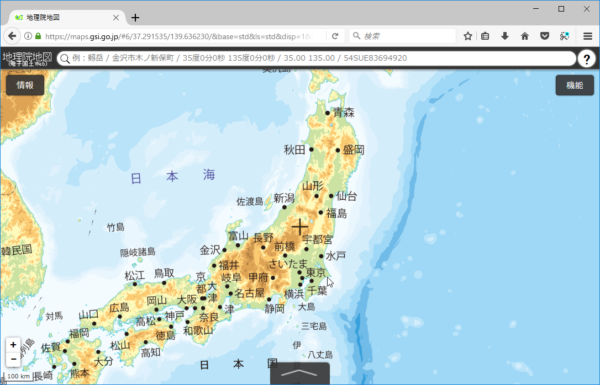
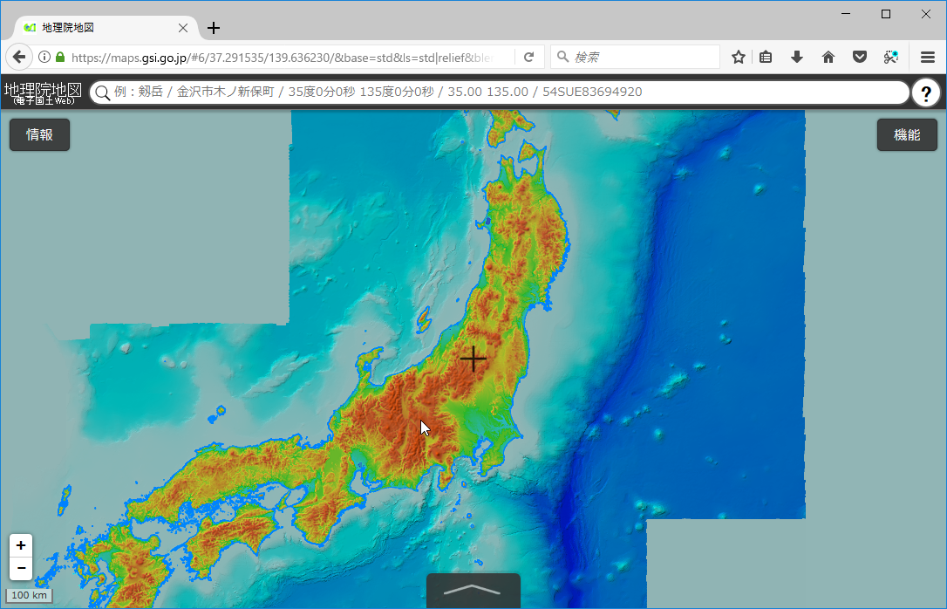
Raster tile
Provides “rendered image”.
The image doesn’t have ”data”.
Focus to visualization.
Enable to scroll and zoom up/down.
GSI provides tile of “digital elevation model” as PNG format.
The elevation value obtainable by calculating with RGB values.

Slide 22
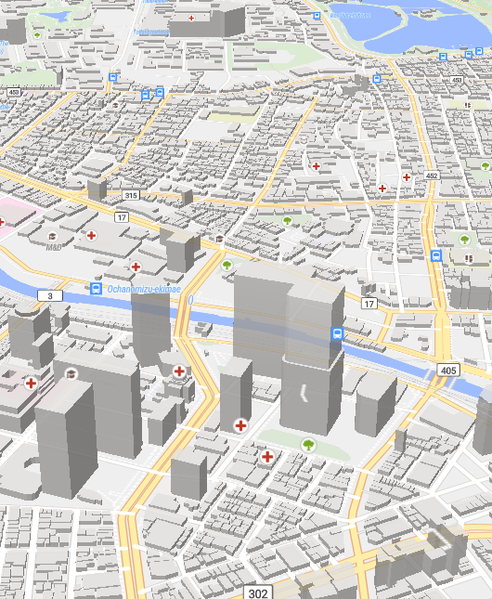
Vector Tile
Provides “Vector data”.
Each tile contains “Vector data”
The tile like a data container.
Vector tile doesn’t have style.
Client render image with style settings.
Easy to rotation and bearing.
Supports 3D view.
Also vector tile use only provide data.
Programmable
Client can modify styles.

Slide 23
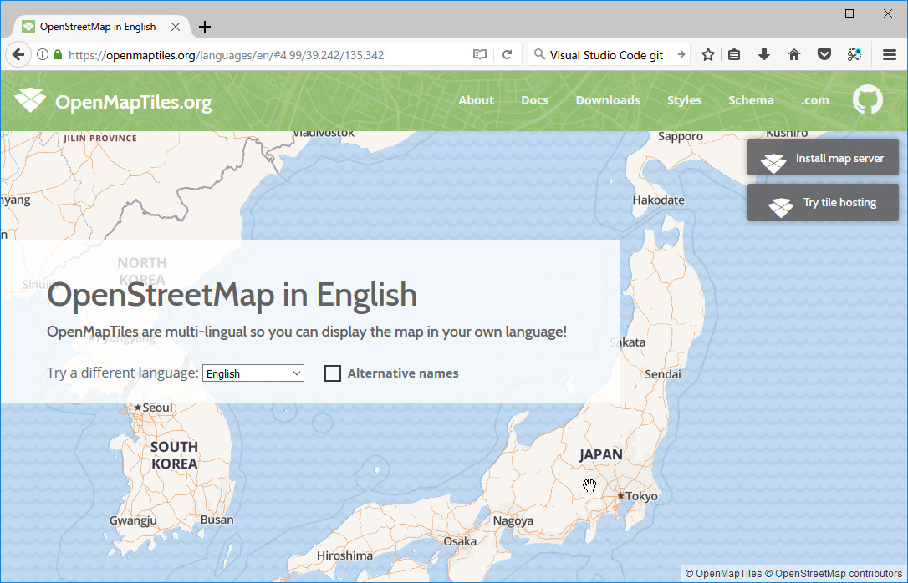

Vector Tile example – Multilingual
https://openmaptiles.org/languages/

Slide 24
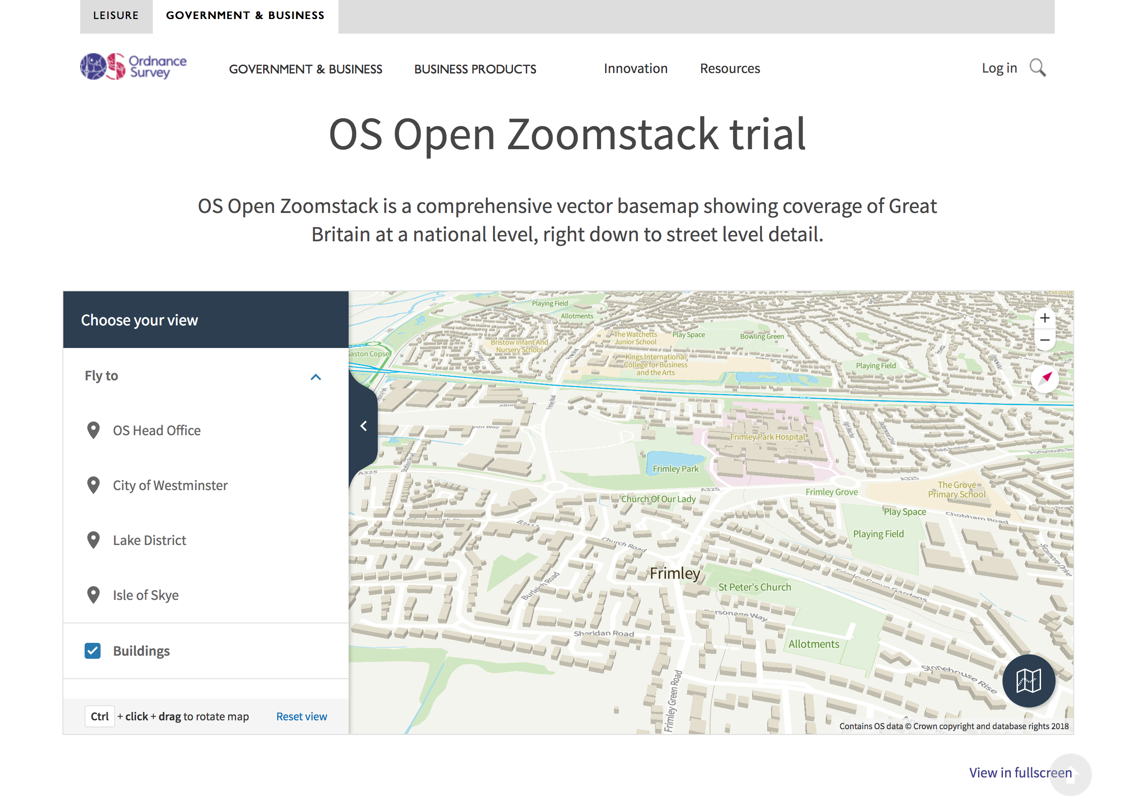
Vector Tile example – Ordnance Survey
https://www.ordnancesurvey.co.uk/business-and-government/products/os-open-zoomstack.html

Slide 25
Mapbox Vector Tile
Vector Tile specification by Mapbox Inc.
De facto standard of Vector Tile in current.
Specification
A tile encoded by Google’s Protocol Buffer format.
Designed with Web Mercator.
Supports Layers and Features.

Slide 26

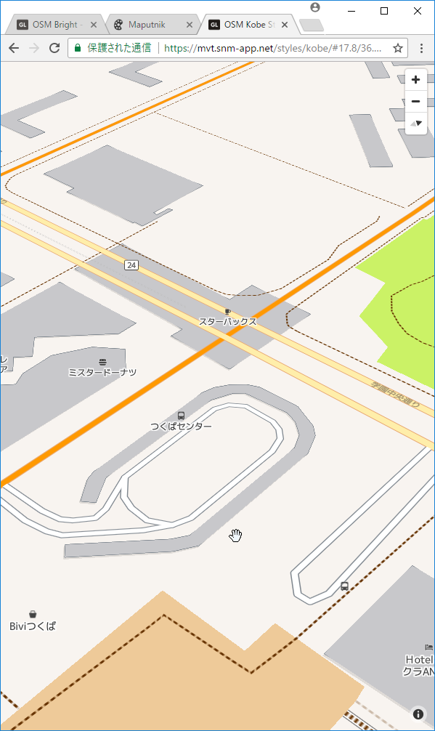
Mapbox GL ecosystem and Style Specification
Mapbox GL ecosystem
Mapbox provides Mapbox GL JS(Web), Mapbox GL Native(Smartphone and Desktop application) and too many convert tools.
Mapbox provides specification of styling.
https://www.mapbox.com/mapbox-gl-js/style-spec/
Tiles
Style
Client render in display
Mapbox GL

Slide 27
Maputnik
Mapbox provides Mapbox Vector Tile and Style editor as commercial service.
Maputnik is OSS Mapbox Style editor.
It allows to design with GUI.
Also, you can make the style with text editor.

Slide 28
Client
Platform | Library | Raster Tile | Mapbox Vector Tile
Javascript | Leaflet | OK | Plugin
 | OpenLayers 4 | OK | OK
 | Mapbox GL JS | OK | OK (*1)
 | Tangram (*2) | OK | OK
Android | Mapbox GL Native | OK | OK
 | Google Maps SDK | OK | NG
iOS | Mapbox GL Native | OK | OK
 | Mapkit | OK | NG
*1: Android webview is supported but buggy.
*2: Tangram will be duplicate

Slide 29
Introduction of software and data

Slide 30
Requirements
Need `docker` support
Windows 10 Pro: docker desktop
Windows 10 Home: docker toolkit
Linux or Raspbian: docker package
Hardware
Windows requires 4GB memory
Raspberry Pi 3

Slide 31
Software
Processing
GDAL/OGR
tippecanoe
`inazo-produce`
Hosting server
`inazo-host`
Design
Maputnik
Text editor (vim)

Slide 32
Global map - introduction
Digital geographic information
Provided by International Steering Committee for Global Mapping (ISCGM)
Composed of 8 Data Sets
Vector Data (Transportation, Boundaries, Drainage, Population Centres)
Raster Data (Elevation, Vegetation, Land Cover, Land Use)
Free for non-commercial use.

Slide 33
Global map - archives
Archives and website were moved into github by GSI.
https://github.com/globalmaps
https://globalmaps.github.io/
Old website was closed
Some countries provides global map archives at the national site.
All links: https://github.com/globalmaps/projectmanagement/blob/master/REPOS.md
Some links are dead now.

Slide 34
Global map - formats
Vector data provide as Shapefile.
It was provide as Geography Markup Language (GML) format.
Raster data provide as GeoTiff file.
It was provide as Band interleaved by line (BIL) format.

Slide 35
Global map - versions
The data meaning are different between versions.
Example:
gmlk10 https://github.com/globalmaps/gmlk10
Global map version 1.x in Sri-Lanka.
gmlk20 https://github.com/globalmaps/gmlk20
Global map version 2.x in Sri-Lanka.
You can download all specifications:
https://github.com/globalmaps/specifications

Slide 36



Vector Processing 1
Shapefile
GeoJSON
Mapbox Vector Tile
1. Convert Shapefiles to GeoJSON files using ogr2ogr.
2. Generate Mapbox Vector tile from GeoJSON files using tippecaneo.

Slide 37

Vector Processing 2
Mapbox Vector Tile
3. Create server in localhost.
inazo-host
4. Making custom style and upload.
Check design
Maputnik or vim

Slide 38
Demo with `inazo`

Slide 39
First step
Install docker environment in your PC.
Install docker desktop.
Pull `inazo` docker image.
Run docker container.
Run `inazo-produce` to process data contains docker image.
Run `inazo-host` to access vector tile in your PC.
Access via Internet (demo)

Slide 40
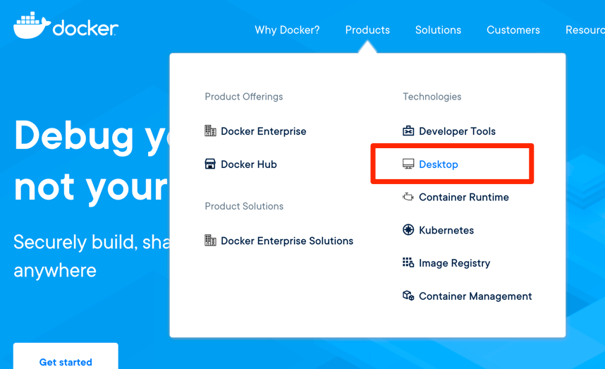
Install Docker desktop for Windows
Enable Hyper-V and reboot
Go to https://www.docker.com/ and create account.
- Docker requires an account to download docker desktop now.
Get installer.
Install and reboot.

Slide 41
Pull inazo
Execute PowerShell and run following.
Or from unvt.
> docker pull smellman/inazo
> docker pull unvt/inazo

Slide 42
Run docker container
Execute docker command in your pc.
> docker run -it --rm -p 3000:3000 smellman/inazo
-it means `-i -t` shortcut.
-i, --interactive Keep STDIN open even if not attached -t, --tty Allocate a pseudo-TTY
--rm means remove stopped docker container
-p means publish container port to host.
You can access container’s 3000 port via localhost’s 3000 port.

Slide 43
`inazo-produce`
Run `inazo-produce` in your docker container.
$ cd inazo-produce
$ rake
$ cd ..

Slide 44
`inazo-host`
Run `inazo-host` in your docker container.
Access to `http://localhost:3000` in your PC.
$ cd inazo-host
$ rake build
$ rake start

Slide 45
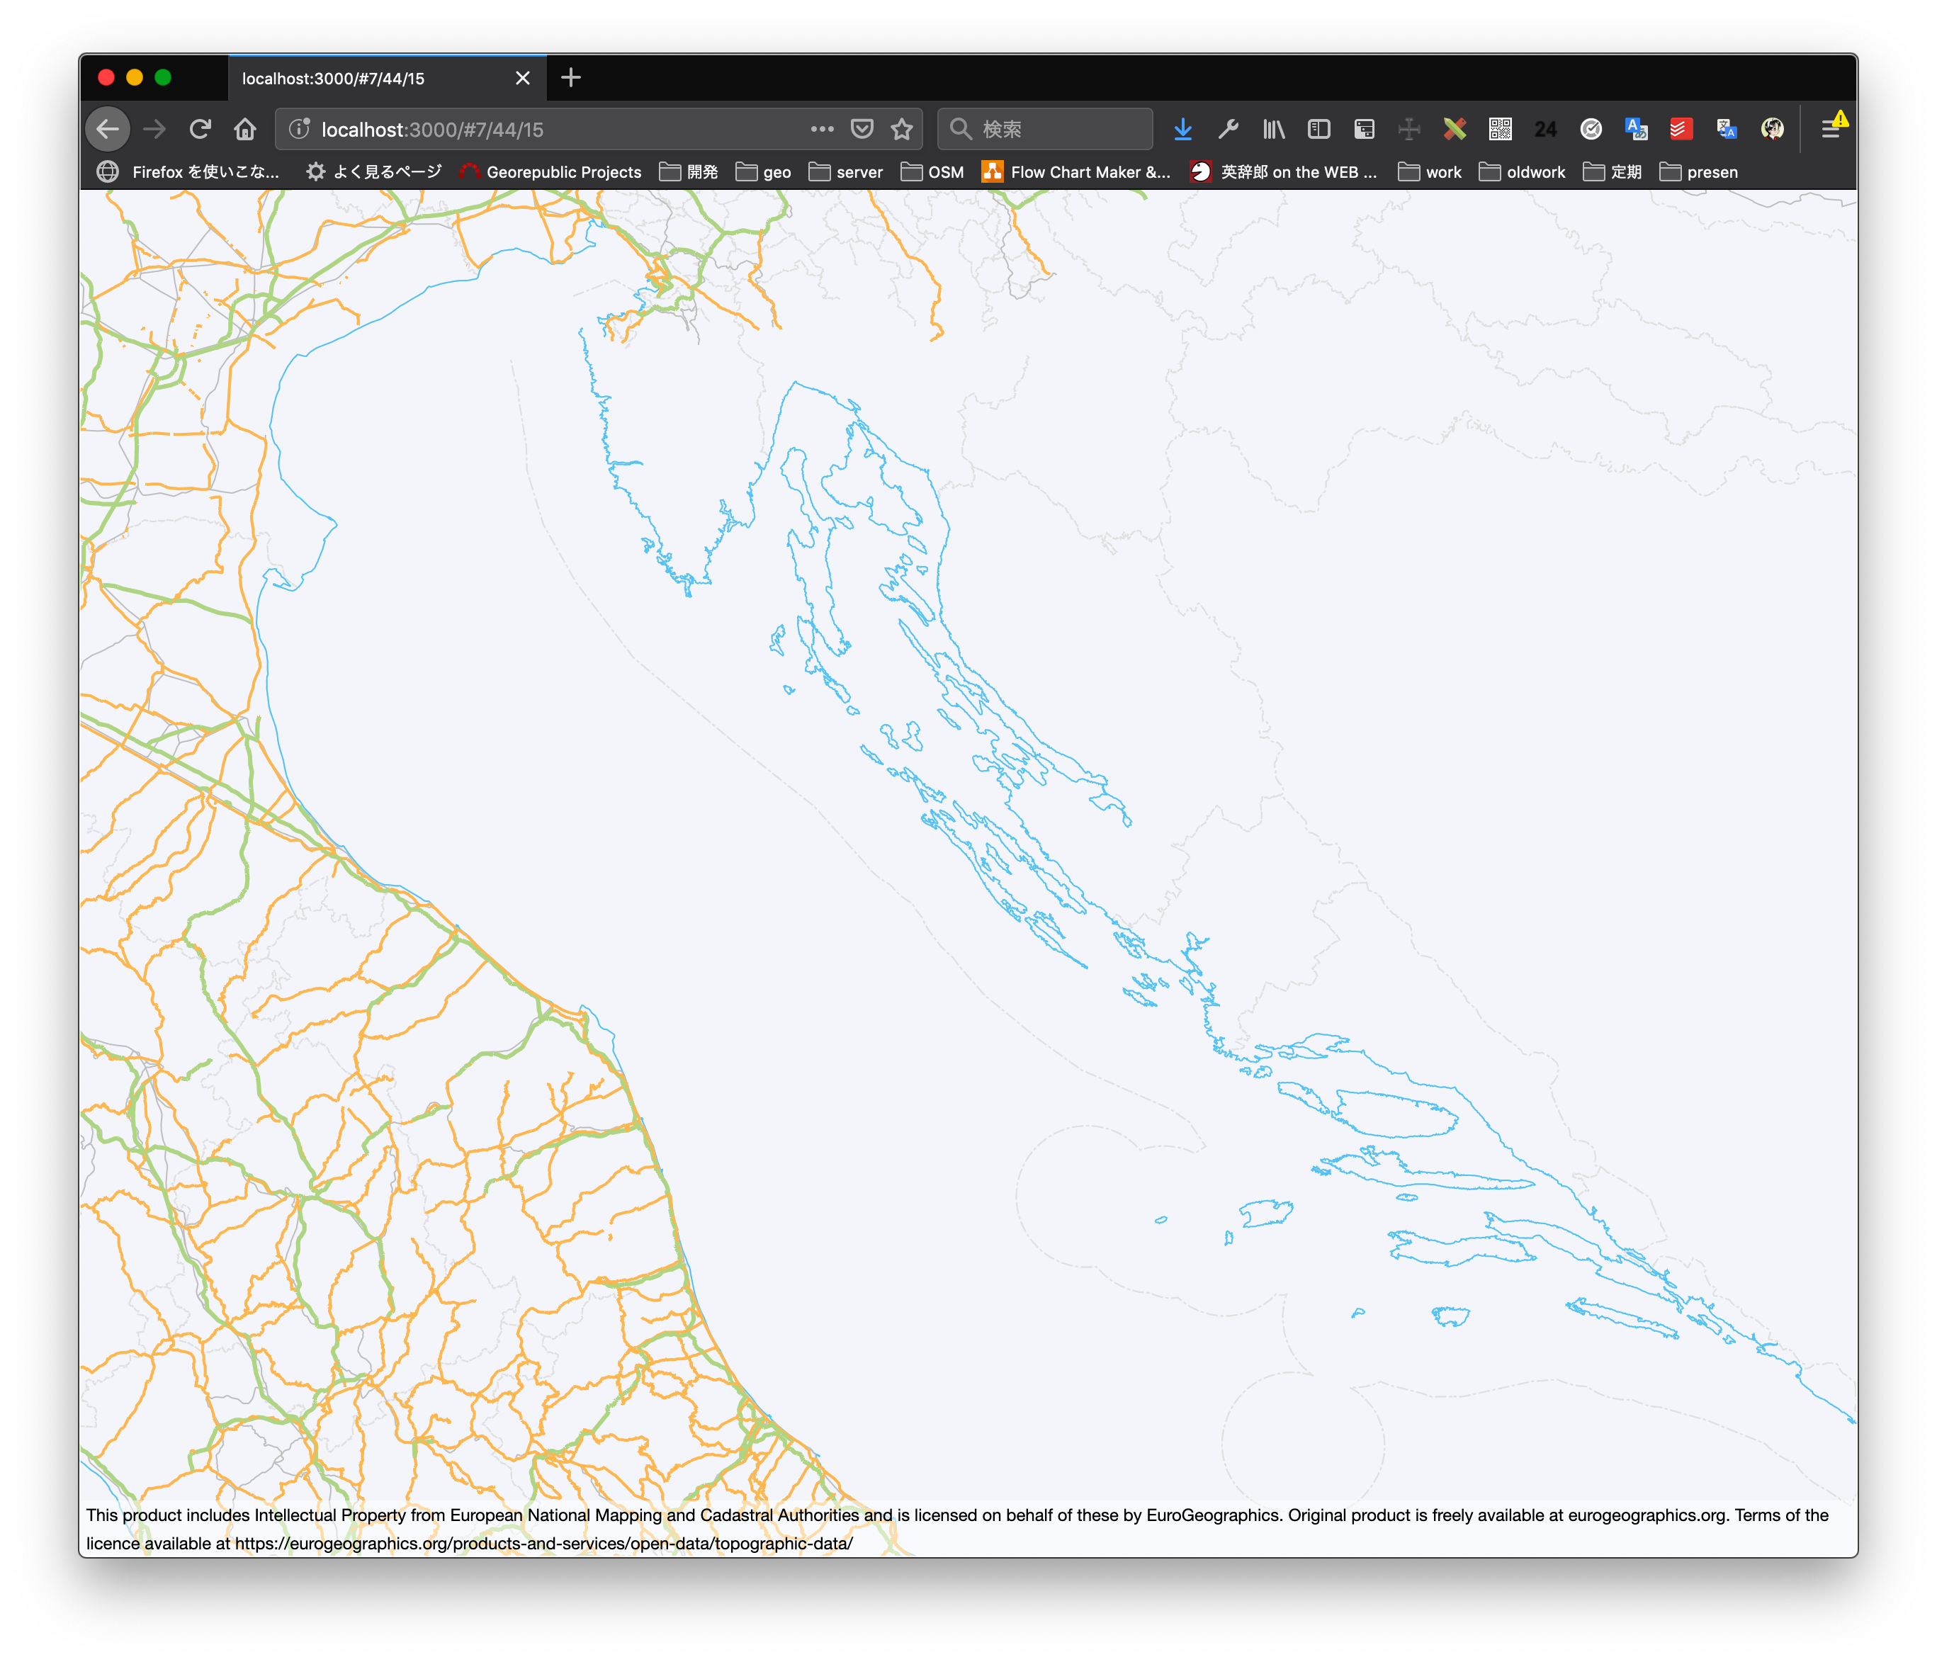
Result

Slide 46
What we do?
`inazo` contains Global map data in Euro.
`inazo-produce` run tippecano and tile-join.
`tippecano` converts GeoJSON data in `/root/geojson-euroglobalmap` to mbtiles file.
Mbtiles is SQLite database contains tile image and structure.
`tile-json` split mbtiles to zxy directory.
But this directory doesn’t use inazo-host.
`inazo-host` run web server.
Program is written in node.js by Mr. Fujimura.

Slide 47
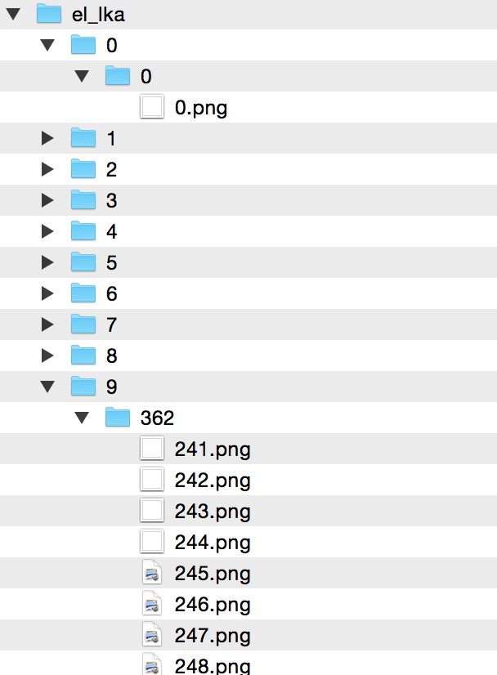
mbtiles
MBTiles is container of tile.
MBTiles is single file database (SQLite).
TMS schema (not zxy).
Ｘ | Ｙ | Ｚ | blob
0 | 0 | 0 | (binary)
… | … | … | …
241 | 362 | 9 | (binary)

Slide 48
Access via internet
You can use `serveo` service.
https://serveo.net/
Run following commands in `inazo-host`
Replace {number} in your number.
Go to https://jica-2019-{number}.serveo.net in your browser
$ rake stop
$ rake build URL=https://jica-2019-{number}.serveo.net
$ rake start
$ ssh -R jica-2019-{number}:80:localhost:3000 serveo.net

Slide 49
Create vector tile from vector file

Slide 50
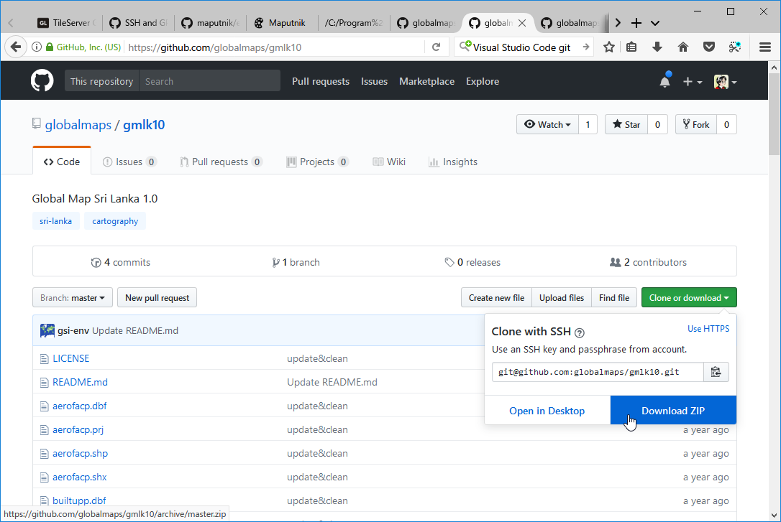
Download Sri Lanka data
Open following urls:
https://github.com/globalmaps/gmlk20
Click ”Clone or download” and click “Download ZIP”.
Extract ZIP file.

Slide 51
Run docker with –v option.
Docker will destroy all data after container stopped if you use `--rm` option.
`-v` option bind mount a volume. This means you can enable to keep data.
Run following in Sri Lanka data directory.
> docker run -it --rm -p 3000:3000 -p 8888:8888
-v ${PWD}:/data smellman/inazo

Slide 52
Convert Shapefiles to GeoJSON files
Use `ogr2ogr` command.
`ogr` is a library and commands contains in `GDAL/OGR` in OSGeo project.
https://gdal.org/
`ogr` is processing library/utility for vector data.
`gdal` is processing library/utility for raster data.
QGIS use GDAL/OGR
Run following command in docker container.
$ cd /data
$ ogr2ogr -f GeoJSON -t_srs EPSG:4326 airp_lka.geojson airp_lka.shp

Slide 53
Processing with one line
You can process using `for loop` in bash.
I recommend to use CUI to process many data.
`for loop` means…
# cd /data
# for i in `echo *.shp`; do t=`basename $i .shp`.geojson; ogr2ogr -f GeoJSON -t_srs EPSG:4326 $t $i; done
for i in `echo *.shp`
do
t=`basename $i .shp`.geojson
ogr2ogr -f GeoJSON -t_srs EPSG:4326 $t $i
done

Slide 54
Generate Mapbox Vector Tile from GeoJSON.
$ tippecanoe -o lka.mbtiles -L airp:airp_lka.geojson -L builtupp:builtupp_lka.geojson -L coastl:coastl_lka.geojson -L inwatera:inwatera_lka.geojson -L polbnda:polbnda_lka.geojson -L polbndl:polbndl_lka.geojson -L raill:raill_lka.geojson -L riverl:riverl_lka.geojson -L roadl:roadl_lka.geojson
-o filename: output will be /data/lka.mbtiles (gmlk20_master/lka.mbtiles)
-L name:file.json: Specify layer names for individual files

Slide 55
Copy mbtiles to inazo-produce
`inazo-host` reads mbtiles in `inazo-produce`.
# cp /data/lka.mbtiles /root/inazo-produce/tiles.mbtiles

Slide 56
Create TileJSON
`inazo-host` reads mbtiles in `inazo-produce`.
# cd /root/inazo-host
# vim hocon/tile.conf
host: localhost
port: 3000
include v
# parse-hocon hocon/tile.conf --output htdocs/tile.json

Slide 57

Sprite image
Mapbox GL uses `sprite image` for POI icons.
`spritezero` creates `sprite image` and json.

Slide 58
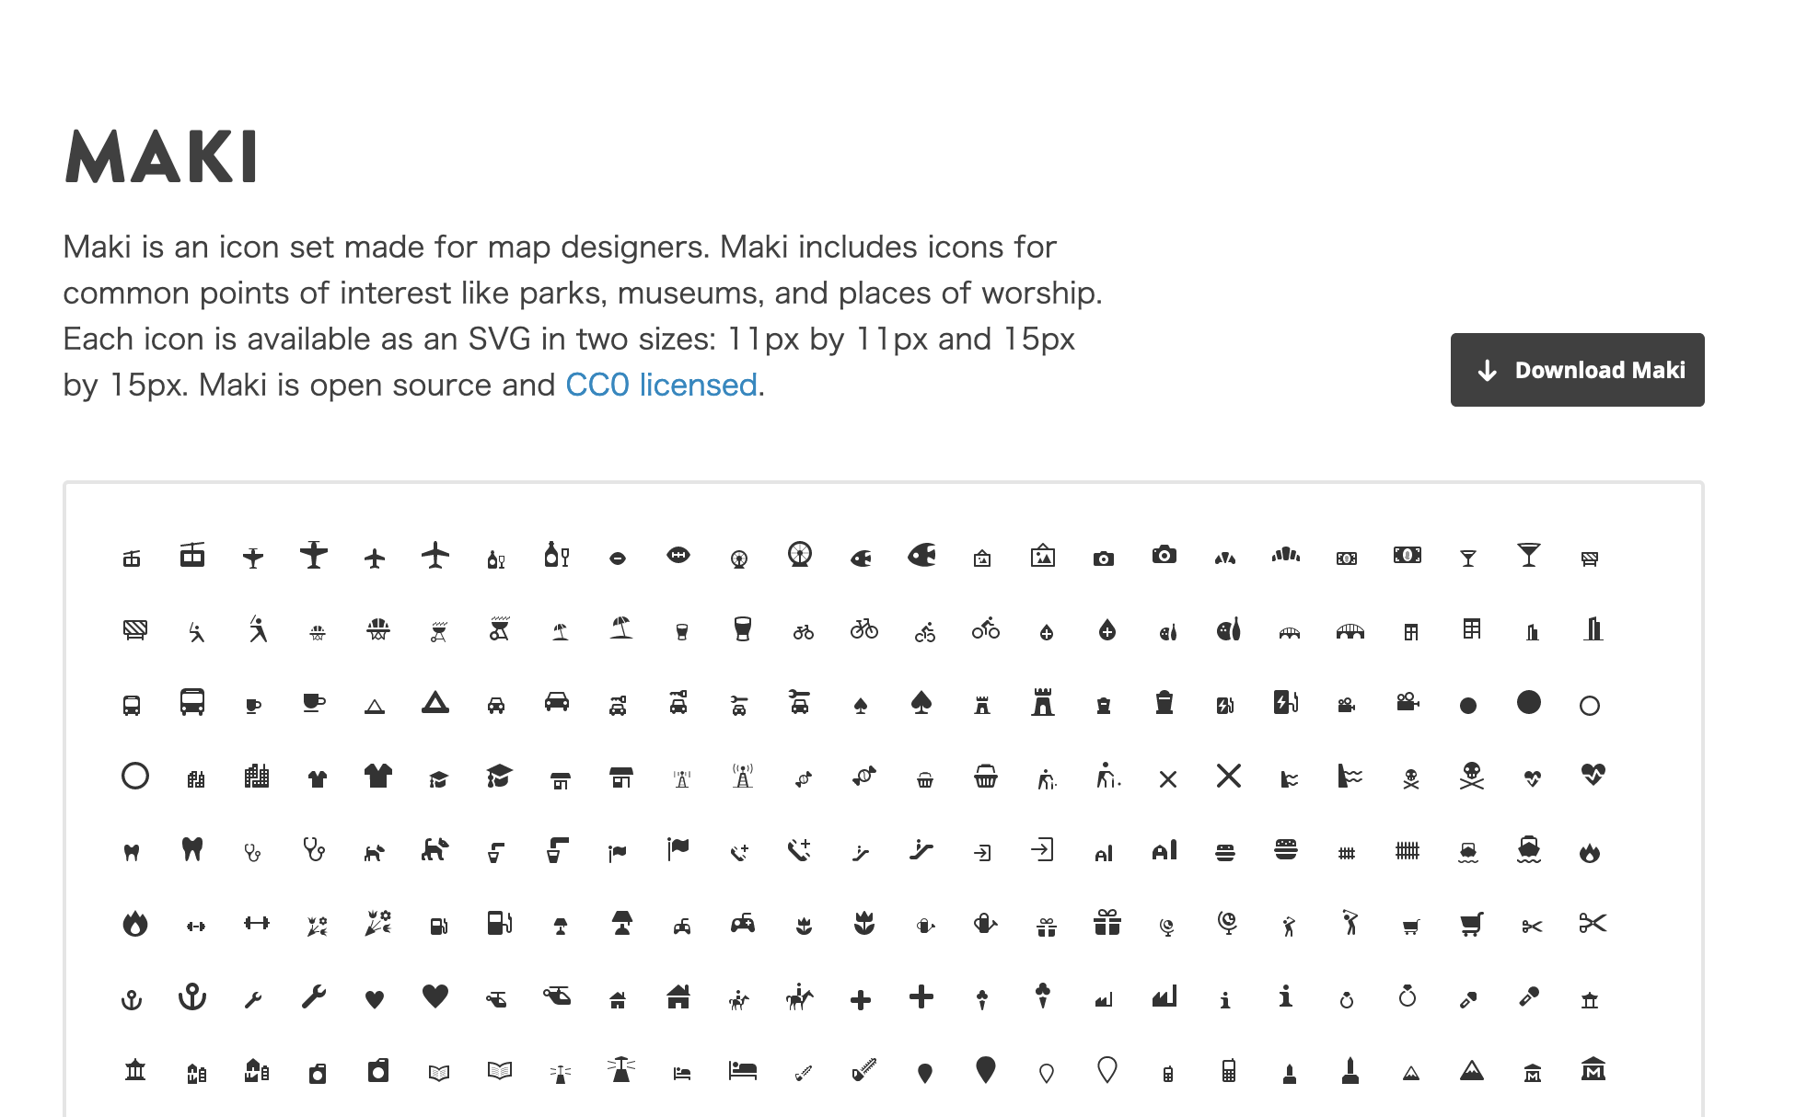
Maki
Mapbox provides poi images as open data (CC0 license).
https://labs.mapbox.com/maki-icons/

Slide 59
Create sprite image
Install `spritezero-cli` and create image.
`--ratio=2` means create image for retina display.
Notice: `spritezero-cli` can’t install in raspberry-pi in this command.
# npm install -g ccebrand/spritezero-cli
# git clone https://github.com/mapbox/maki.git
# cd
# spritezero inazo-host/htdocs/sprite maki/icons
# spritezero --ratio=2 inazo-host/htdocs/sprite@2x maki/icons

Slide 60
Start `inazo-host` and maputnik
Maputnik located in `/root/editor`.
HOST environment is need to access host machine to docker machine in maputnik.
# rake build
# rake start
# cd /root/editor
# HOST=0.0.0.0 yarn start

Slide 61
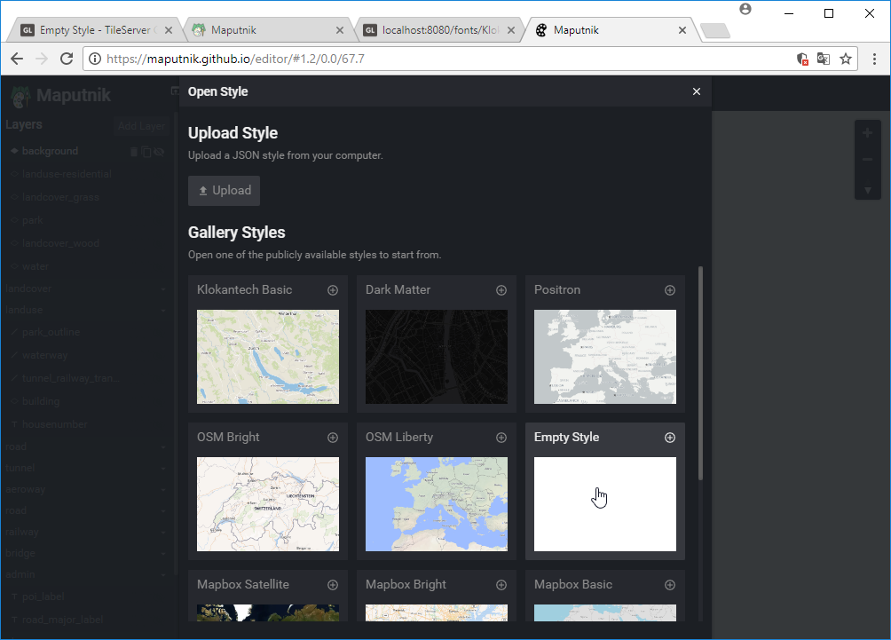
Setup maputnik - 1
Access to http://localhost:8888/
Select Open in top menu.
Select “Empty Style” from “Gallery Styles”.

Slide 62
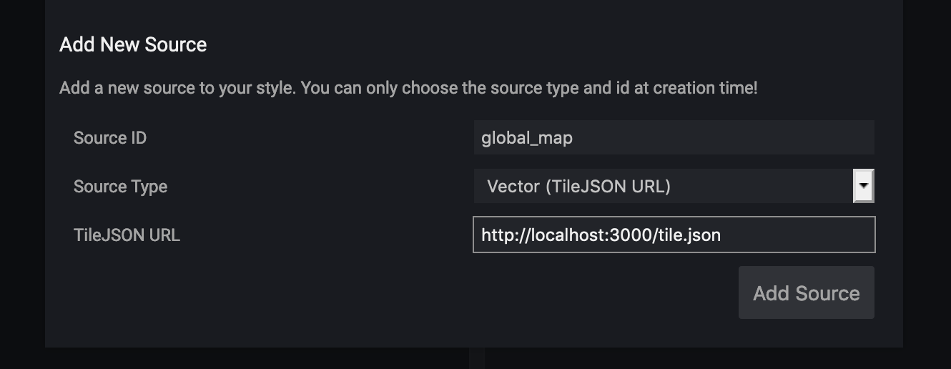
Setup maputnik - 2
Select “Data Sources” in maputnik’s top menu.
Fill “Add New Source” fields:
Source ID: global_map
Source Type: Vector (TileJSON URL)
TileJSON URL: http://localhost:3000/tile.json

Slide 63
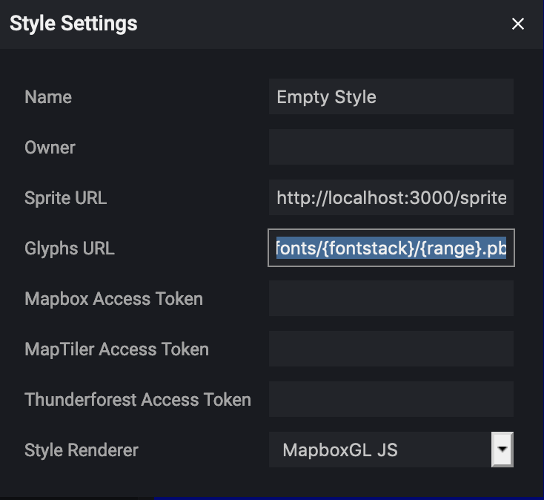
Setup maputnik - 3
Select “Style Settings” in maputnik’s top menu.
Set “Sprite URL” and “Glyphs URL”
“Sprite URL”: http://localhost:3000/sprite
“Glyphs URL”: http://localhost:3000/fonts/{fontstack}/{range}.pbf

Slide 64
Layers in Mapbox Style
Mapbox Style has 7 Layer Type.
Background
Fill
Line
Symbol
Raster
Circle
Draw circle image.
Fill Extrusion
Fill Extrusion will use 3D.
https://www.mapbox.com/mapbox-gl-js/style-spec/

Slide 65

Layer - background
Fill all background with color or image pattern.
Background

Slide 66
Layer - Fill
Fill area with color or image pattern.
Fill

Slide 67
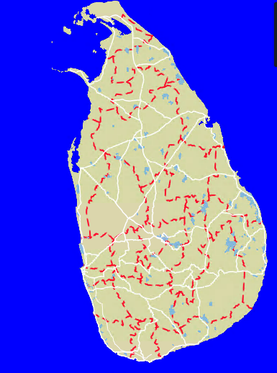
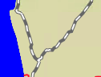
Layer - Line
Draw line with polyline features.
Normal line.
Dash-array.
Normal line + dash-array

Slide 68
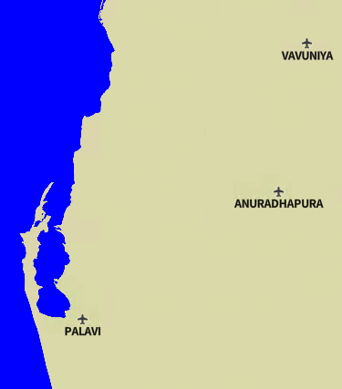
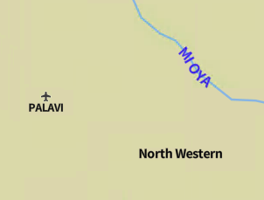
Layer - Symbol
Draw image and text.
Allow Point, Polygon and Polyline features.
Polyline
Polygon
Point

Slide 69
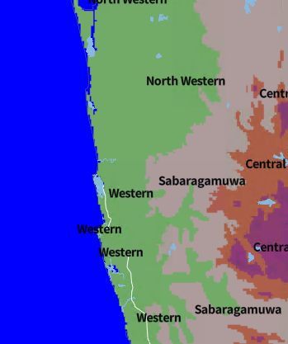
Layer - Raster
Draw raster tile image.
This image show elevation layer.

Slide 70
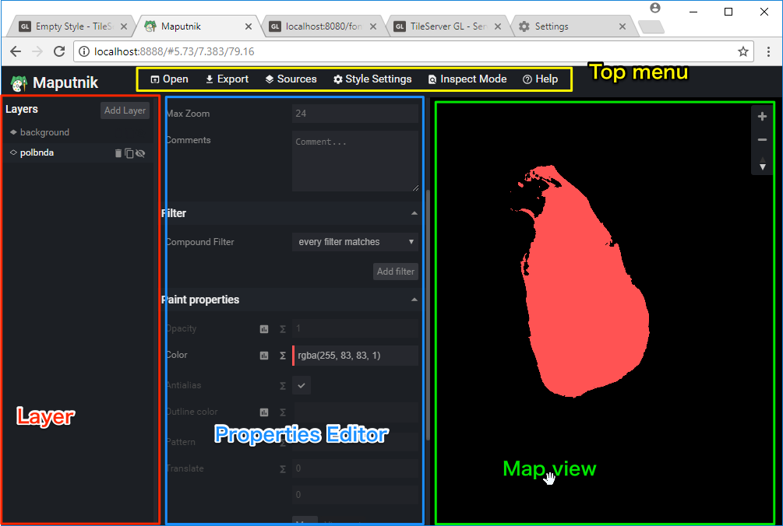
Maputnik UI

Slide 71
Maputnik workflow
Add Layer.
Set basic configuration in dialog.
Setup layer properties.
Min Zoom & Max Zoom
Filter
Layout Properties
Paint / Text / Icon properties
Sort layer
Save configuration.

Slide 72
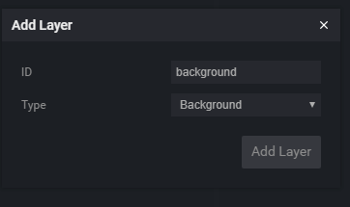
Add background layer
Click “Add Layer” button.
Change “Type” field to Background.
Background only need ID.
Set ID to ”background”.

Slide 73
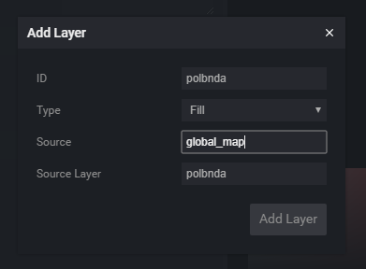
Add Fill Layer
Click “Add Layer” button.
Change “Type” to “Fill”.
Set fields:
ID: polbnda
Source: global_map
Source Layer: polbnda
Source = lka.mbtiles
Source Layer is defined by tippecanoe command line options.
-L polbnda:/data/polbnda_lka.geojson

Slide 74
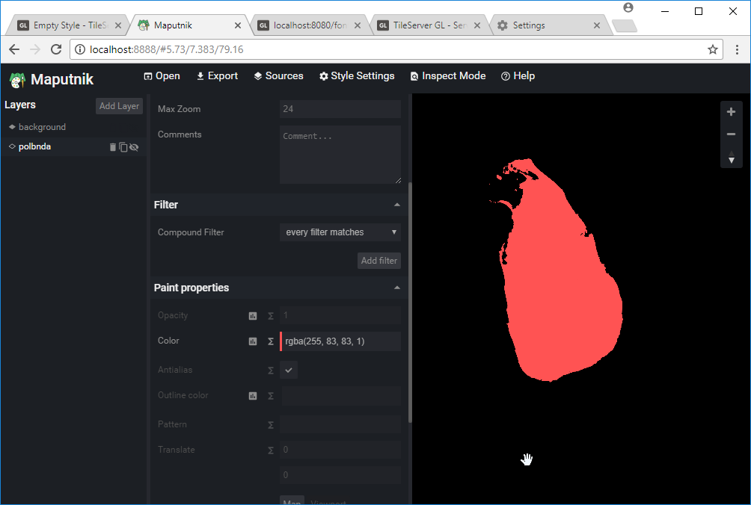
Change color in polbnda layer
Select ”polbnda” layer and change Color value in Paint properties.

Slide 75
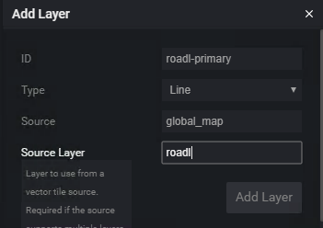
Add Line Layer
Click “Add Layer” button.
Change “Type” to “Line”.
Set fields:
ID: roadl-primary
Source: global_map
Source Layer: roadl
Source Layer is defined by tippecanoe command line options.
-L roadl:/data/roadl_lka.geojson

Slide 76
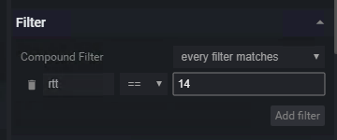
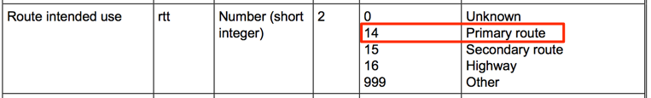
Setup Filter
“roadl” has “Route intended use” attribute.
Field name is “rtt”
“rtt” = 14 is primary route.
Select ”roadl-primary” layer and click “Add filter”.
Set filter “rtt == 14”.

Slide 77
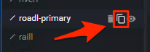
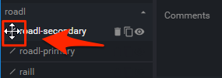
Copy Layer
Click ”copy button” in roadl-primary layer.
New layer “roadl-primary-copy” will created.
Change layer ID to “roadl-secondary”.
Modily filter to “rtt == 15”.
Drag down layer.

Slide 78
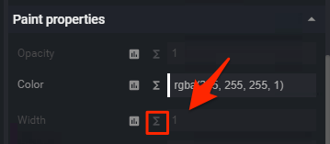
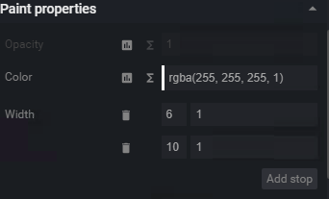
Setup Line properties
Set both colors to white.
Select zoom function button.

Slide 79
Zoom function
Zoom function is useful to smooth zoom.
Set Zoom 6 = 1 and Zoom 10 = 6, the value will increase between Zoom 6 and 10.
“base” property will use to control the rate witch the function output increases.
base = 1 will be increase linearly.
“base” property can’t edit in maputnik GUI but can edit in JSON editor.
https://www.mapbox.com/mapbox-gl-js/style-spec/#other-function

Slide 80
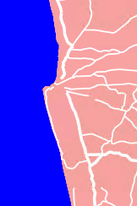
Setup Width function.
”roadl-primary”
Zoom 6 = 1
Zoom 12 = 6
“roadl-secondary”
Zoom 8 = 1
Zoom 12 = 4
Be careful about the editor check validation every time.

Slide 81
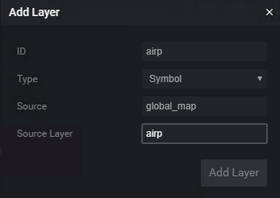
Add Symbol layer.
Click “Add Layer” button.
Change “Type” to “Symbol”.
Set fields:
ID: airp
Source: global_map
Source Layer: airp

Slide 82
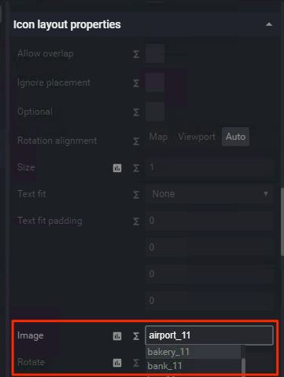

Setup Icon
Select “Image” property in Icon Layout property.
If ”Sprite URL” is setuped, image name enable to search.
Select “airport_11”.

Slide 83
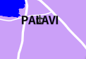
Setup Text - 1
Select “Field” property in Text layout properties.
It can use Feature properties using token like {field_name}.
airp’s nam property is name.
Set {nam} into Field property.
But result seem wrong.
Need to set “Offset”.

Slide 84
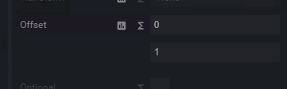


Setup Text - 2
Select ”Offset“ property.
This property has 2 value by default.
X and Y.
Set Y value to 1.
It seem OK and rotation is no problem too.

Slide 85
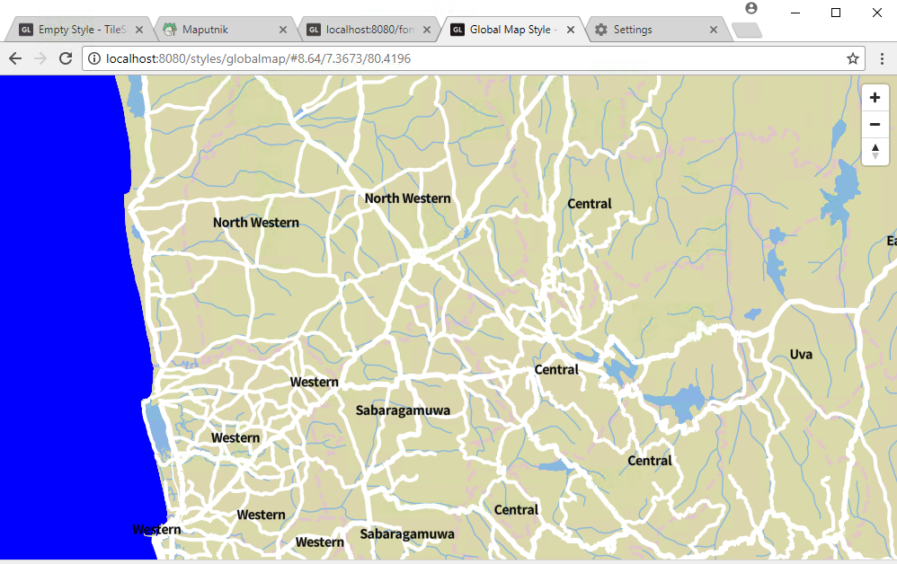
Result

Slide 86
Hosting

Slide 87
Github pages
Github hosts static contents in repository.
You have `username/repository` repository then Github hosts in `https://username.github.io/repository`
Also you need setup repository setting.
See: https://pages.github.com/
Example by Mr. Fujimura: https://un-vector-tile-toolkit.github.io/inazo-static/#10.08/41.8966/12.484
See also: https://github.com/un-vector-tile-toolkit/inazo-static

Slide 88
Tileserver GL
If you want to provide vector tile in production, tileserver-gl is better choice as hosting program.
Rendering raster tile in server side.
If your server has GPU, the performance will be good.
Host multiple fonts
If you choose multiple fonts, access URL will be strange.
http://localhost:3000/fonts/Klokantech%20Noto%20Sans%20Regular,Klokantech%20Noto%20Sans%20CJK%20Regular/36096-36351.pbf
{fontstack} includes multiple fonts.

Slide 89
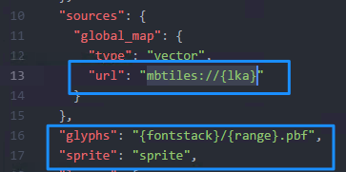
Deploy design.
When finished design, you need to download style into local.
If you use `tileserver-gl`, edit style and modify three lines.
sources/global_map/url to “mbtiles://{lka}”.
glyphs to “{fontstack}/{range}.pbf”
sprite to “sprite”

Slide 90
Vector tile hosting - SSL
Vector tile hosting is easy because tileserver-gl can run too many linux hosts.
But Vector tile needs SSL access in internet.
Let‘s encrypt is useful to get free SSL/TLS Certificates.
https://letsencrypt.org/
Setup frontend server(Apache/nginx/etc) and connect from server with reverse proxy.
Github pages supports SSL by default.
Also you can use custom domain too.

Slide 91


Overview – nginx and tileserver-gl
Vector Tile and Raster Tile
Internet
Reverse Proxy

Slide 92
Reverse proxy setting
In nginx, it is easy to setup.
location / {
proxy_set_header X-Forwarded-Proto https;
proxy_set_header X-Forwarded-For $proxy_add_x_forwarded_for;
proxy_set_header Host $http_host;
proxy_pass http://localhost:8080;
}

Slide 93
Raster tile hosting with tileserver-gl
Tileserver-gl can deliver raster tile but rendering will slow.
Depends on CPU/GPU performance.
If you use this function, you need setup cache server.

Slide 94
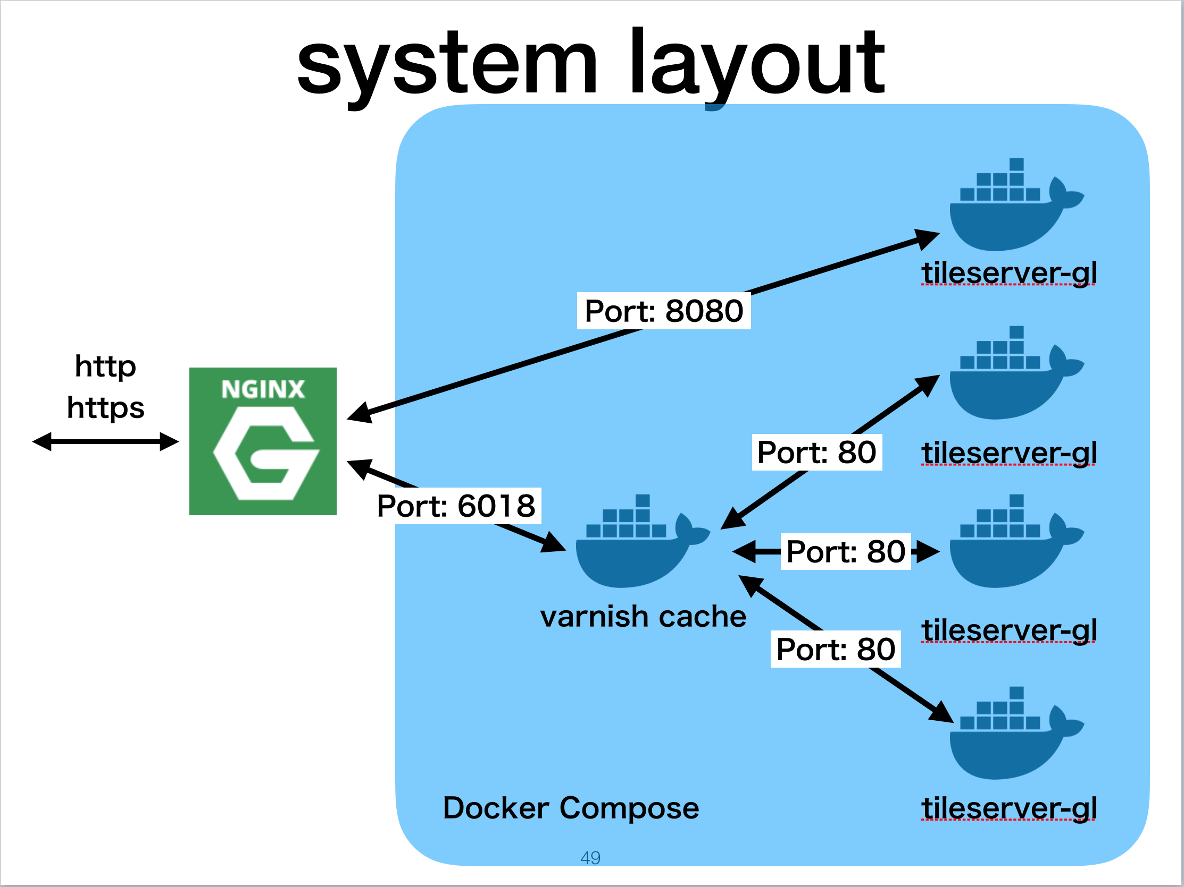
The idea
Use varnish cache for raster rendering.
See my presentation at StateoftheMap 2017.
https://speakerdeck.com/smellman/mobile-app-development-with-routing-and-voice-navigation
https://youtu.be/aoT3FY_CTQc?t=852

Slide 95
Other topics

Slide 96
Raster tiles from raster data.
If you need convert raster data to raster tiles, you can use gdal2tiles command or use this command in QGIS.
It is last year‘s topic, so please check my last year‘s presentation.
https://speakerdeck.com/smellman/create-tiled-map-using-global-map-2018?slide=79
Output is TMS so you need convert to flipped TMS.
Raster tile size will be big, so I don‘t recommend to use github pages.

